Slide 1
Ease your workload by implementing Configuration-as-Code for Microsoft 365
Yorick Kuijs
Notes:
Cloud Solution Architect @ Microsoft
Co-owner Microsoft365DSC
Author of Microsoft365DSC whitepaper
Working with DSC since 2016

Slide 2

Yorick Kuijs
Cloud Solution Architect @ Microsoft
Co-owner Microsoft365DSC
Author of Microsoft365DSC whitepaper
Working with DSC since 2016

Slide 3
Who is managing multiple Microsoft 365 tenants?

Slide 4
Who is using Azure DevOps (or similar tools)?

Slide 5
And is not a developer?

Slide 6
Who is familiar with PowerShell Desired State Configuration?

Slide 7
Agenda
Desired State Configuration Intro
What is Microsoft365DSC
Automating the change process

Slide 8
Desired State Configuration Intro

Slide 9
Desired State Configuration intro
Introduced in PowerShell v4, extended in PowerShell v5
Framework based on open standards
Apply desired configuration and monitor configuration drift
Desired state = Current state
Uses a declarative approach

Slide 10
Imperative approach
Create registry value using imperative approach:
New-Item -Path 'HKLM:\SOFTWARE\Microsoft\PowerShellDSC'
New-ItemProperty -Path 'HKLM:\SOFTWARE\Microsoft\PowerShellDSC' -PropertyType 'Dword' -Name 'DemoValue' -Value 0
Code will throw errors when executed multiple times.

Slide 11
Declarative approach
Create registry value using declarative approach:
Registry 'Example'
{
Key = 'HKLM:\SOFTWARE\Microsoft\PowerShellDSC'
ValueName = 'DemoValue'
ValueType = 'Dword'
ValueData = 0
}

Slide 12
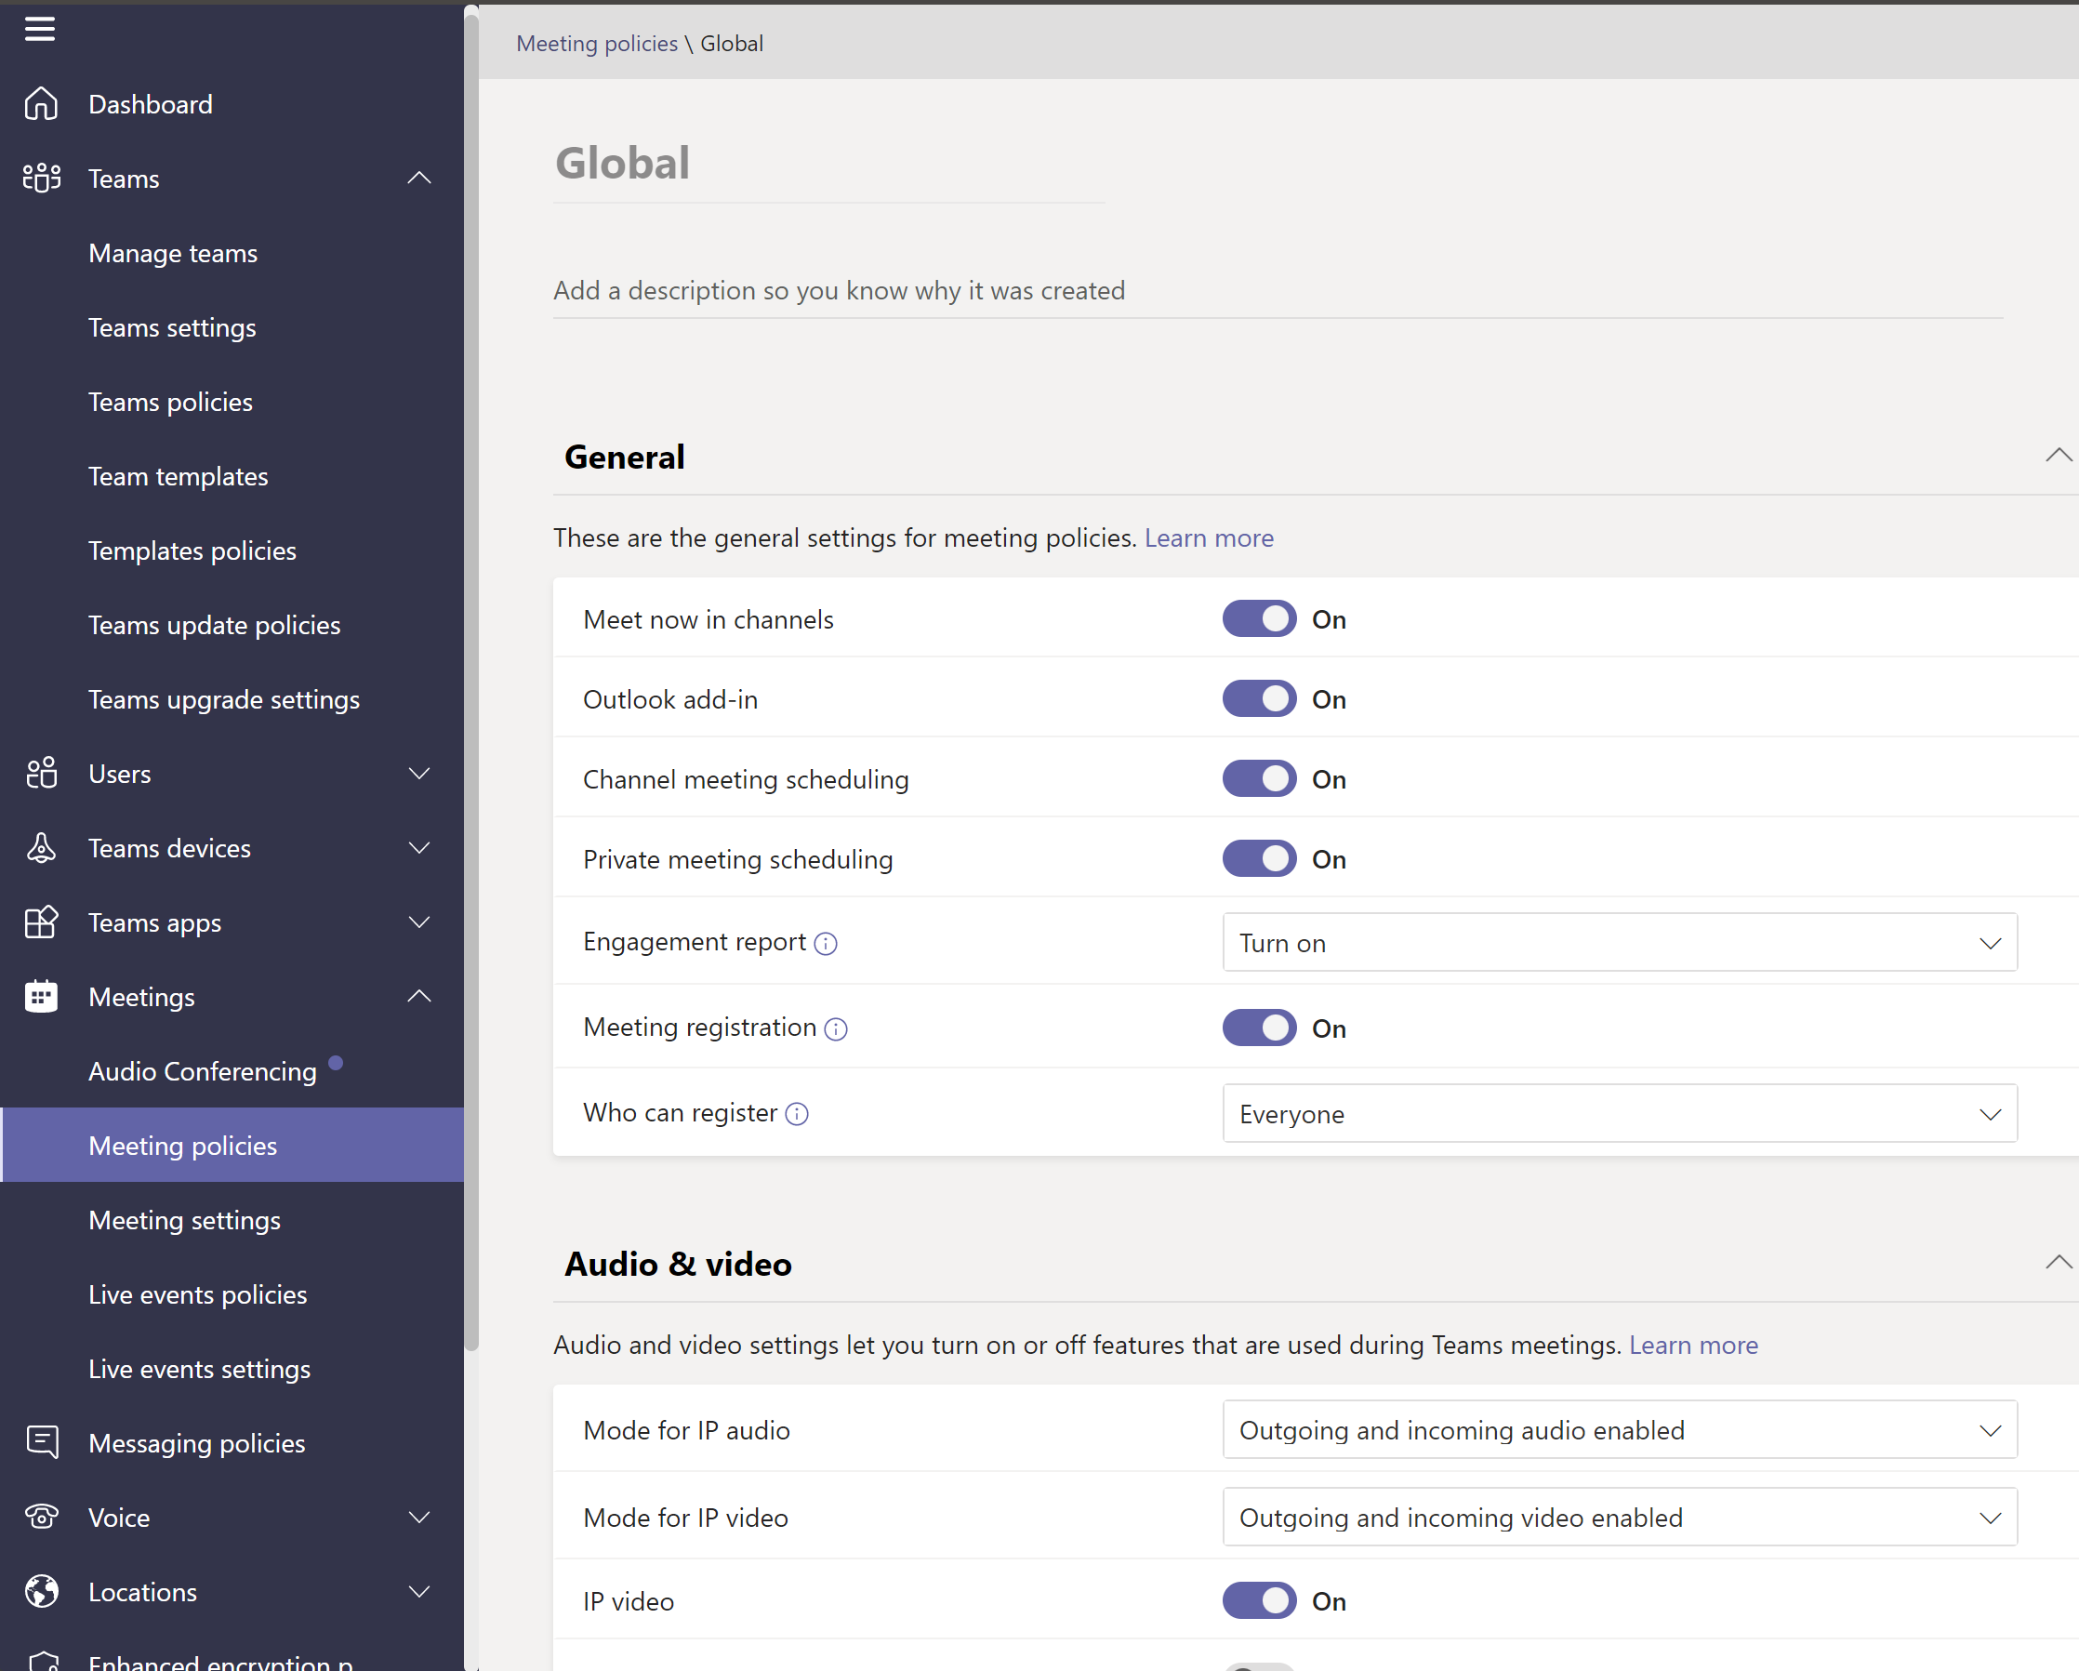
Configuration-as-Code
TeamsMeetingPolicy 'Example Meeting Policy'
{
Identity = 'Global'
AllowMeetNow = $True
AllowOutlookAddIn = $True
AllowChannelMeetingScheduling = $True
AllowPrivateMeetingScheduling = $True
AllowEngagementReport = 'Enabled'
WhoCanRegister = 'Everyone'
IPAudioMode = 'EnabledOutgoingIncoming'
IPVideoMode = 'EnabledOutgoingIncoming'
AllowIPVideo = $True
AllowNDIStreaming = $False
AllowIPAudio = $True
Ensure = 'Present'
Credential = $Credential
}

Slide 13

Notes:
Run script

Slide 14
What is Microsoft365DSC

Slide 15
About Microsoft365DSC
Open-source module for PowerShell DSC
Hosted on GitHub
Enables the use of DevOps practices to manage Microsoft 365
Led by Microsoft engineers, maintained by the community
New versions published weekly to the PowerShell Gallery
Documentation published on microsoft365dsc.com

Slide 16

Features
Automate
Report
Export
Monitor
Synchronize
Assess

Slide 17









Deploy Desired State
Automate the Configuration of all M365 Workloads
Write your Microsoft 365 Configuration as Code
Notes:
Lets have a look at all possibilities of Microsoft365DSC:
(CLICK)
- As mentioned before, it can automate deployment of a tenant configuration
* You document your configuration as code and automatically deploy using PowerShell DSC

Slide 18


Monitor Configuration Drift
Analyze for Configuration Drift
Act on detected drifts: Fix, Log or Alert
Notes:
(CLICK)
- But not just that, it can also monitor for configuration drift
* Once a configuration is deployed, PowerShell DSC will periodically (by default every 15 minutes) check if your tenant still is in the desired state and if not, create an alert or automatically fix itself

Slide 19
Export Current State
Export
Notes:
(CLICK)
Microsoft365DSC also allows you to export the current tenant configuration to PowerShell DSC format
* It extracts a full fidelity configuration from any existing M365 tenant
* You can use that export as a starting point for your own configuration

Slide 20



Document Current State
Export
Generate
Reports
Notes:
But with the created export, you can do much more:
(CLICK)
- You can generate documentation out of it
* Simply convert any extracted configuration into an HTML, Excel or JSON report
* That way you can do a quick and easy review of your tenant configuration

Slide 21


Compare Configurations
Assess against Blueprint
Assess against tenant
(Same or different tenant)
Assess Existing Environments Against Known Good Configurations
Tenant A
Tenant B
Discrepancy Report
M365DSC Blueprints
Export
Generate
Export
Discrepancy Report
Notes:
But there is more:
(CLICK)
- You can compare a tenant against a created blueprint
* For example when you want to check if all of your tenants still match the security baseline
(CLICK)
- Or you can compare multiple exported configurations for any differences
* This can be two different tenants, like Test and Production
* Or two points in time, like a monthly export so you can see what has changed over time

Slide 22
Sync Configuration Between Tenants
Tenant A
Tenant B
Export
Automate
Notes:
And lastly:
When you are able to export and apply a configuration
(CLICK)
You can also copy a configuration to a different tenant for example for testing or to quickly provision a new tenant
* Simply export the configuration of one tenant and import that into another tenant

Slide 23
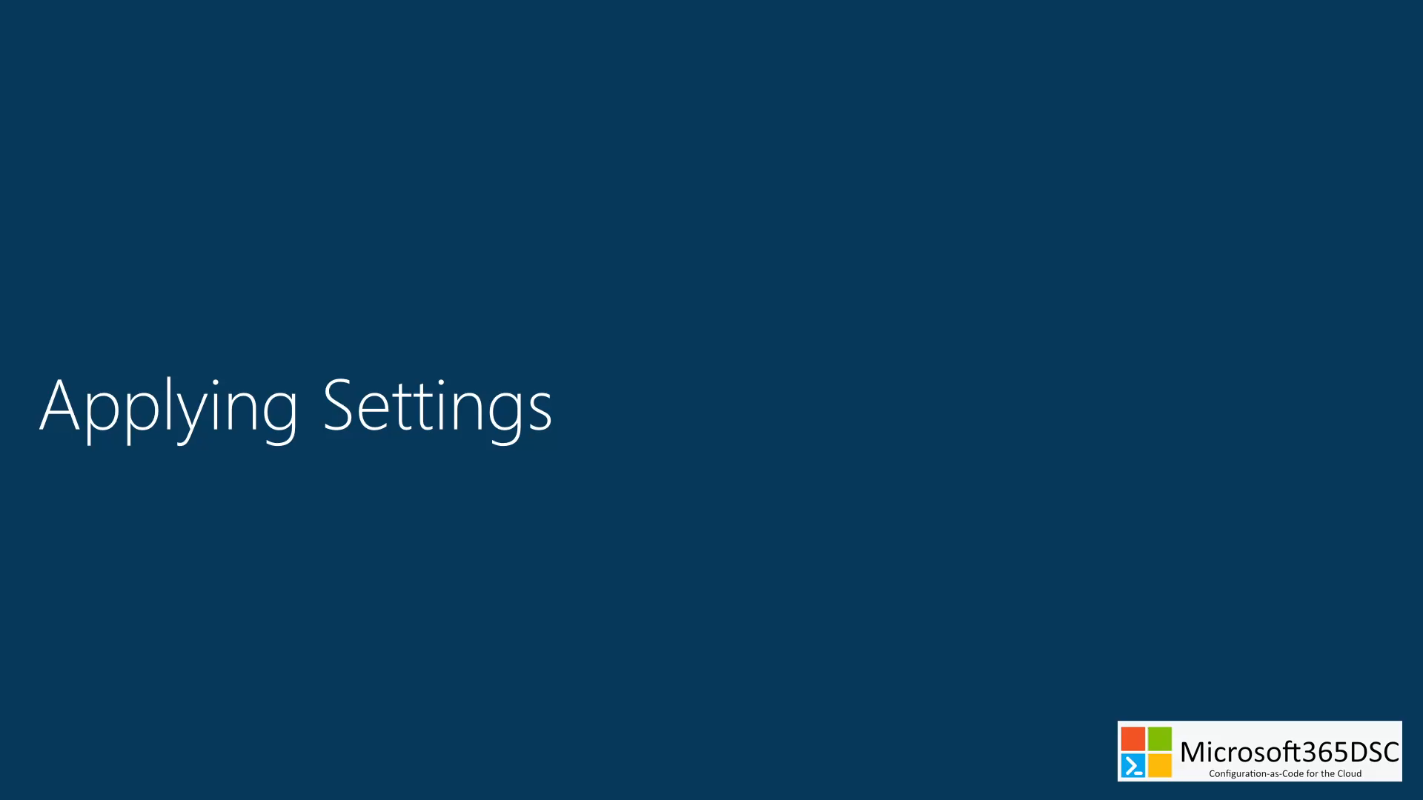

Slide 24


Slide 25
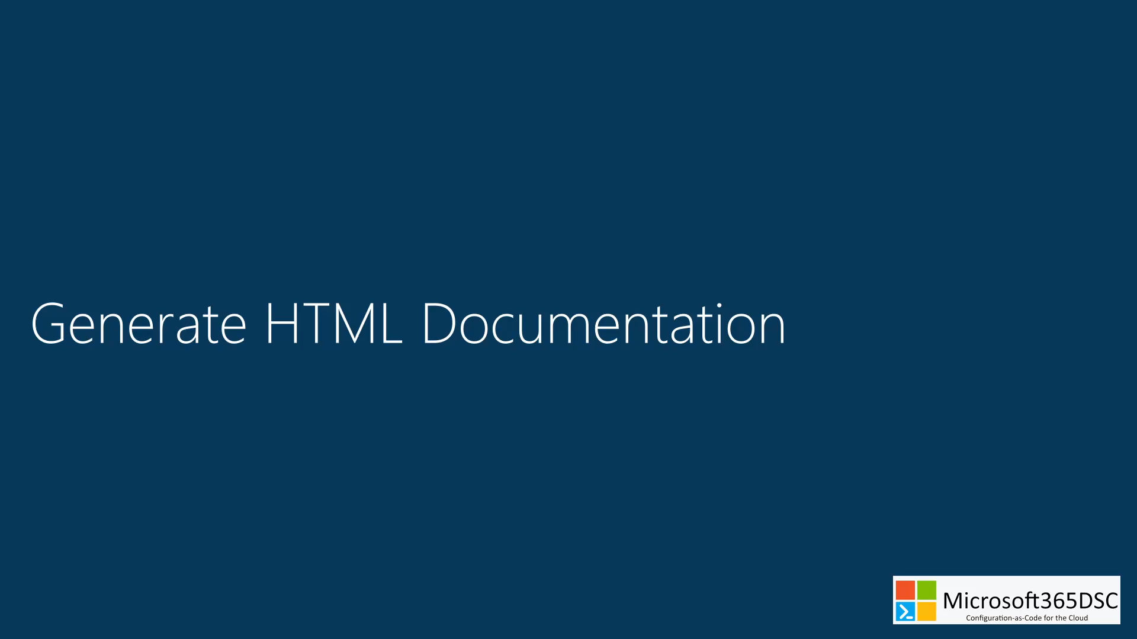

Slide 26
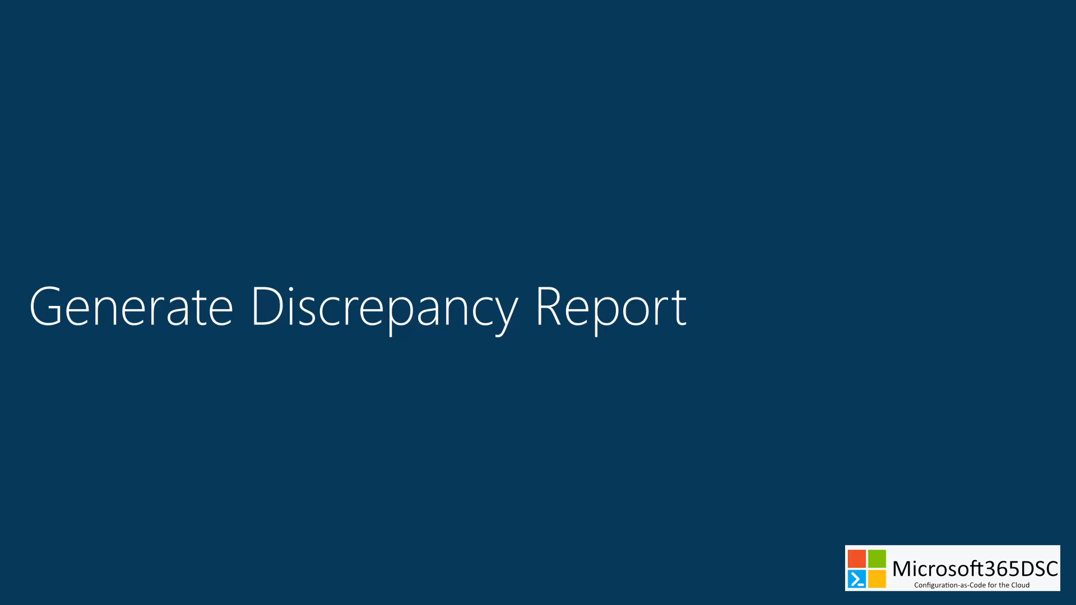

Slide 27
Notes:
https://microsoft365dsc.com
https://www.powershellgallery.com
https://github.com/microsoft/Microsoft365DSC
https://export.microsoft365dsc.com
Install-Module Microsoft365DSC
Update-M365DscDependencies
Uninstall-M365DscOutdatedDependencies
Export-M365DSCConfiguration -Components @("SPOBrowserIdleSignout", "SPOTenantCdnEnabled", "SPOTenantSettings") -Credential $Credential
New-M365DSCReportFromConfiguration -ConfigurationPath .\M365TenantConfig.ps1 -Type HTML -OutputPath C:\Temp\ExpertsLive\report.html

Slide 28
Automating the change process

Slide 29
The manual process
Store the configurations in a folder
Implement changes on the main copy
Compile the configurations manually
Deploy the MOF files manually
-> No version control
-> No quality control
-> Error prone
-> Time consuming

Slide 30

Automate the change process
Azure DevOps will solve these problems:
Store configurations in a repository
Submit changes via a pull request
Use pipelines to:
Implement quality gates
Automate configuration compilation
Deploy changes to the environments

Slide 31





Automate the change process!
Azure
Key Vault
Admins
Validate & Approve
Deploy
Staging
Fork
Admin1
Main Repository
Get
Credentials
Create
Pull Request
Compile
MOFs
Deploy
MOFs
Check Pull Request
Build
Release
Pipeline
Pipeline
Commit & Sync
Code Review
& Merge PR
Deploy
Master
DSC Config
Build
Admin1
Production
Admins
Pipeline
Add/Modify/Delete

Slide 32
Let’s see that in action!

Slide 33
Work in progress
Improvements to the solution:
Add composite resources for other workloads
Change Self-Hosted agent to Cloud-Hosted agent
Replace Credentials with Certificate Thumbprint
Merge multiple layers of configuration data
Add QA tests to the Build pipeline

Slide 34
Resources
GitHub
https://Github.com/Microsoft/Microsoft365DSC
Official Website
https://Microsoft365DSC.com
https://export.Microsoft365DSC.com
PowerShell Gallery
https://www.powershellgallery.com/packages/Microsoft365DSC
DevOps Whitepaper
https://aka.ms/M365DSCWhitepaper

Slide 35
Resources
Getting started
https://learn.microsoft.com/en-us/powershell/dsc/getting-started/wingettingstarted
https://learn.microsoft.com/en-us/powershell/dsc/configurations/configurations
https://learn.microsoft.com/en-us/powershell/dsc/configurations/write-compile-apply-configuration
Composite resources
https://learn.microsoft.com/en-us/powershell/dsc/resources/authoringresourcecomposite
Configuration data
https://learn.microsoft.com/en-us/powershell/dsc/configurations/configdata
https://learn.microsoft.com/en-us/powershell/dsc/configurations/separatingenvdata
Content
https://github.com/ykuijs/events

Slide 36

Questions?

Slide 37
Thank you!

